Slide 1

Visualization through Kibana

Slide 2
1. Introduction and install.
Kibana is an open source data visualization plugin for Elastic-search. It provides visualization capabilities on top of the content indexed on an Elastic-search cluster. Users can create bar, line and scatter plots, or pie charts and maps on top of large volumes of data.
Kibana could be installed on mac, windows and Linux operate system. Most of time we install it on Linux such as Debian or Ubuntu, you could install Kibana and Elasticsearch on Linux through next step:

Slide 3
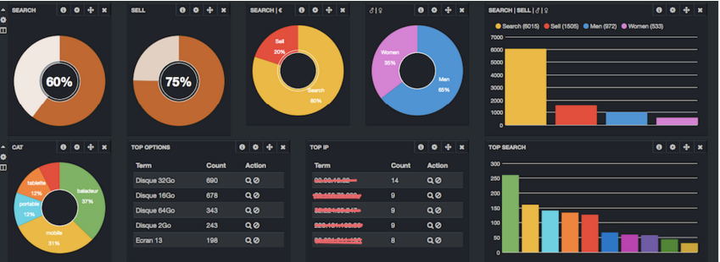
Install of Elasticsearch and Kibana

Slide 4

Elasticsearch
A search engine based on Lucene. It provides a distributed, multitenant-capable full-text search engine with an HTTP web interface and schema-free JSON documents.
Requirement
1. At least 4GB memory for PC or VMware
2. Elasticsearch is built using Java, and requires at least Java 8 in order to run. Only Oracle’s Java and the OpenJDK are supported. We recommend installing Java version 1.8.0_73 or later

Slide 5
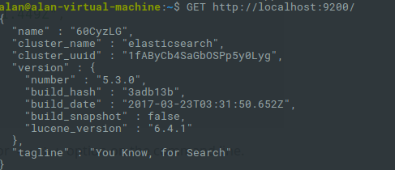
Set-up
Download and install the .zip package
wget https://artifacts.elastic.co/downloads/elasticsearch/elasticsearch-5.3.0.zip
unzip elasticsearch-5.3.0.zip
cd elasticsearch-5.3.0/
Running Elasticsearch from the command line
./bin/elasticsearch
Checking that Elasticsearch is running

Slide 6
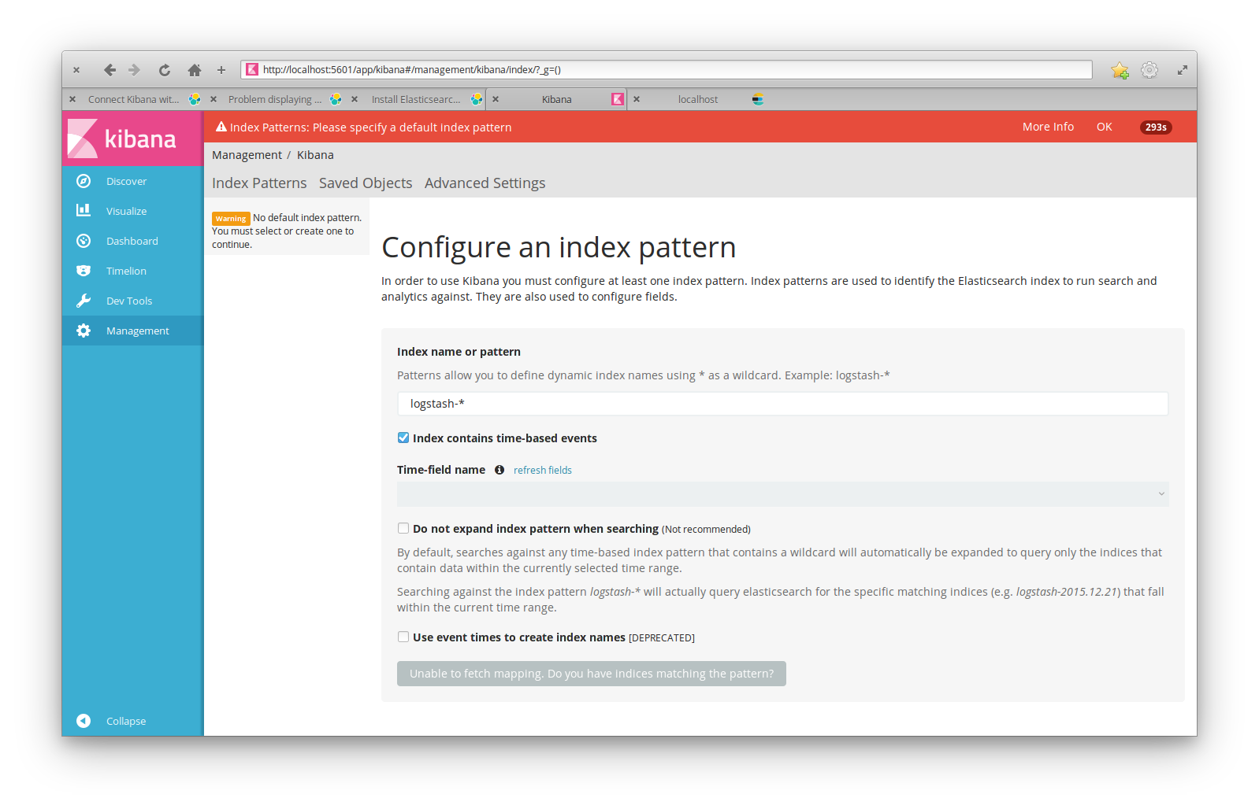
Kibana set-up
Download and install the Linux package
wget wget https://artifacts.elastic.co/downloads/kibana/kibana-5.3.0-linux-x86_64.tar.gz
tar -xzf kibana-5.3.0-linux-x86_64.tar.gz
cd kibana/
Running Kibana from the command line
./bin/kibana

Slide 7
Kibana connection with Elasticsearch
Before you can start using Kibana, you need to tell it which Elasticsearch indices you want to explore. The first time you access Kibana, you are prompted to define an index pattern that matches the name of one or more of your indices. That’s it. That’s all you need to configure to start using Kibana. You can add index patterns at any time from the Management tab.
To configure the Elasticsearch indices you want to access with Kibana:
Open localhost:5601
Specify an index pattern that matches the name of one or more of your Elasticsearch indices. By default, Kibana guesses that you’re working with data being fed into Elasticsearch by Logstash. If that’s the case, you can use the default logstash-* as your index pattern.
Select the index field that contains the timestamp that you want to use to perform time-based comparisons. Kibana reads the index mapping to list all of the fields that contain a timestamp. If your index doesn’t have time-based data, disable the Index contains time-based events option.
Click Create to add the index pattern. This first pattern is automatically configured as the default. When you have more than one index pattern, you can designate which one to use as the default by clicking on the star icon above the index pattern title from Management > Index Patterns.

Slide 8
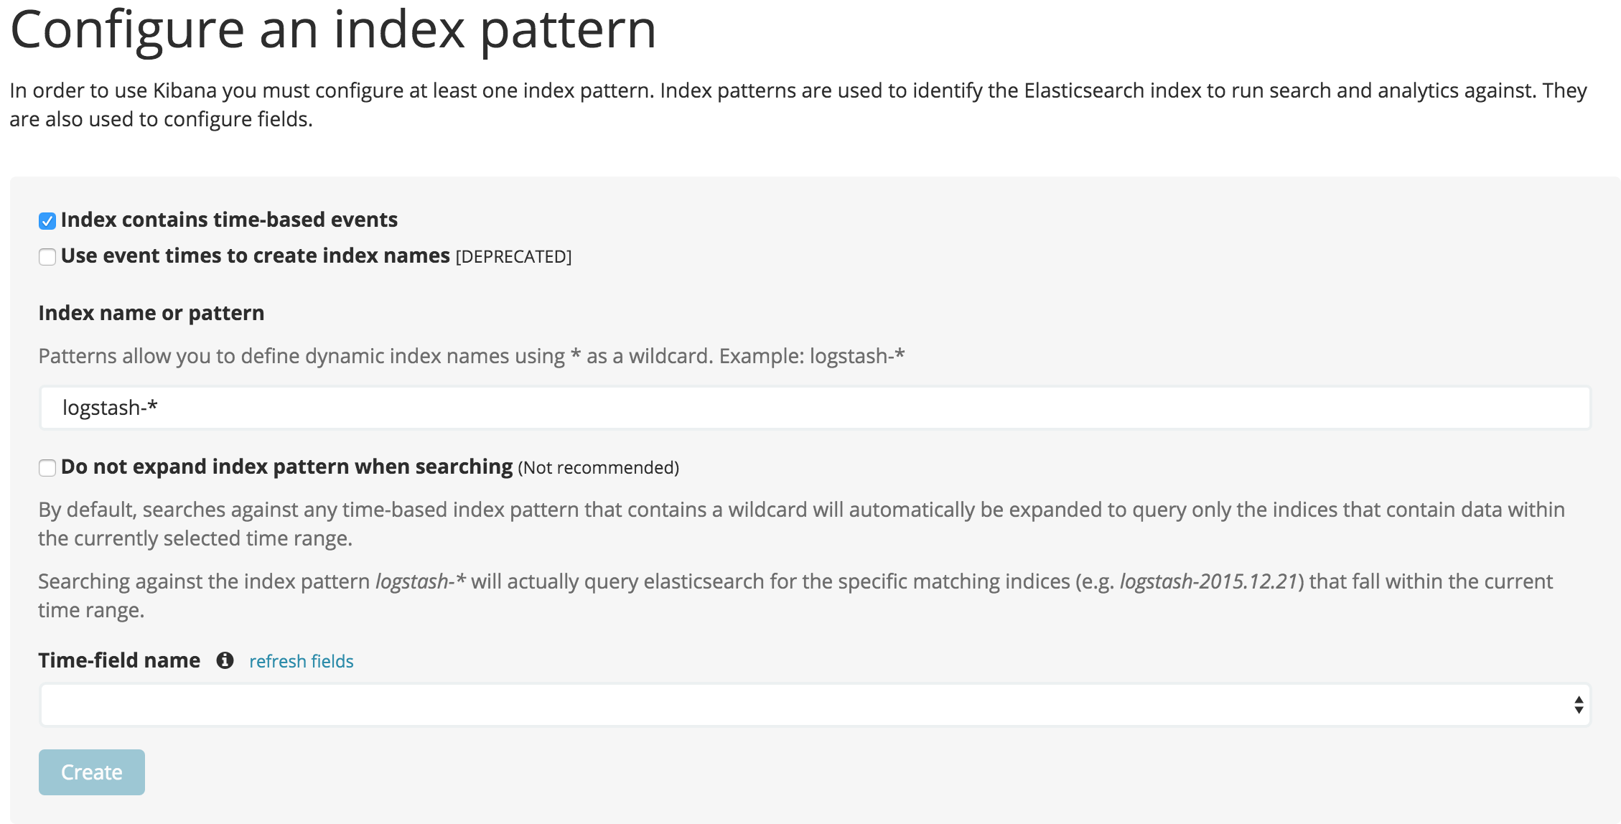
Kibana connection with Elasticsearch

Slide 9
2. Visulization step:
Load a sample data set into Elasticsearch.
Define an index pattern
Explore the sample data with Discover
Set up visualizations of the sample data

Slide 10
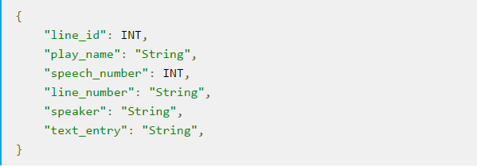
2-1. Load a sample data set into Elasticsearch:
Here we use the William Shakespeare dataset from https://download.elastic.co/demos/kibana/gettingstarted/shakespeare.json
The dataset is organized in the following schema:
{"index":{"_index":"shakespeare","_type":"scene","_id":1}}
{"line_id":2,"play_name":"Henry IV","speech_number":"","line_number":"","speaker":"","text_entry":"SCENE I. London. The palace."}

Slide 11
2-1. Load a sample data set into Elasticsearch:
Before we load the Shakespeare data sets, we need to set up mappings for the fields. Mapping divides the documents in the index into logical groups and specifies a field’s characteristics, such as the field’s searchability or whether or not it’s tokenized, or broken up into separate words.
curl -XPUT http://localhost:9200/shakespeare -d '
{
"mappings" : {
"_default_" : {
"properties" : {
"speaker" : {"type": "string", "index" : "not_analyzed" },
"play_name" : {"type": "string", "index" : "not_analyzed" },
"line_id" : { "type" : "integer" },
"speech_number" : { "type" : "integer" }
}
}
}
}
';

Slide 12
2-1. Load a sample data set into Elasticsearch:
Previous command in a terminal (eg bash) to set up a mapping for the Shakespeare data set.
This mapping specifies the following qualities for the data set:
The speaker field is a string that isn’t analyzed. The string in this field is treated as a single unit, even if there are multiple words in the field.
The same applies to the play_name field.
The line_id and speech_number fields are integers.
At this point we’re ready to use the Elasticsearch bulk API to load the data sets with the following commands:
curl -XPOST 'localhost:9200/shakespeare/_bulk?pretty' --data-binary @shakespeare.json

Slide 13
2-1. Load a sample data set into Elasticsearch:
Verify successful loading with the following command:
curl 'localhost:9200/_cat/indices?v'
You should see output similar to the following:
health status index pri rep docs.count docs.deleted store.size pri.store.size
yellow open shakespeare 5 1 111396 0 17.6mb 17.6mb

Slide 14
2-2. Define an index pattern:
Each set of data loaded to Elasticsearch has an index pattern. In the previous section, we could define the Shakespeare data set an index named shakespeare.
Any pattern that matches the name of an index we’ve loaded will work. Open a browser and navigate to localhost:5601. Click the Settings tab, then the Indices tab. Click Add New to define a new index pattern. Two of the sample data sets, the Shakespeare plays and the financial accounts, don’t contain time-series data. Make sure the Index contains time-based events box is unchecked when you create index patterns for these data sets. Specify shakes* as the index pattern for the Shakespeare data set and click Create to define the index pattern, then define a second index pattern named ba*.

Slide 15
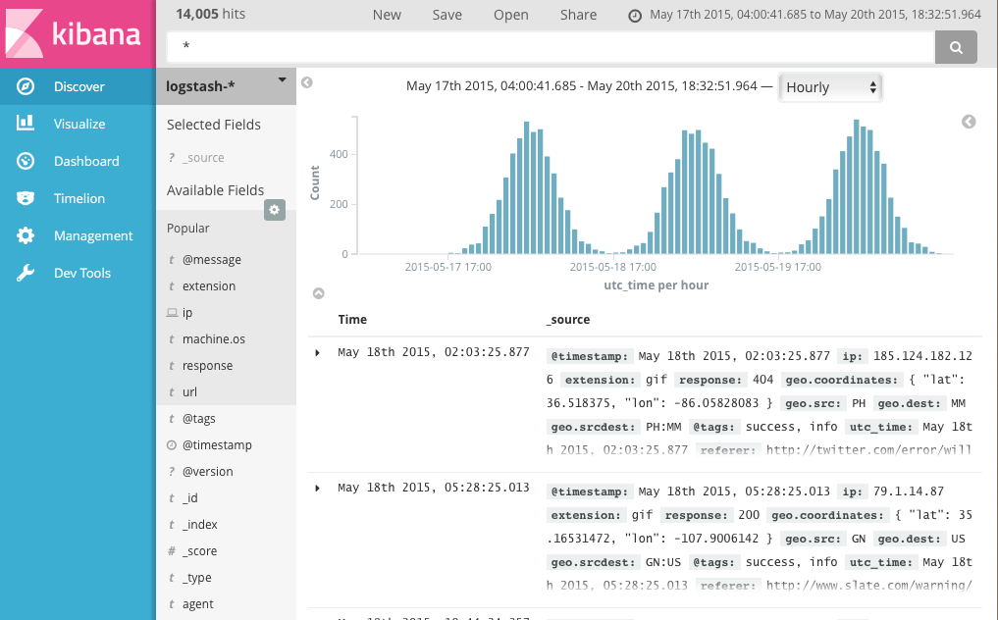
2-3. Discover data:
Click Discover in the side navigation to display Kibana’s data discovery functions:

Slide 16
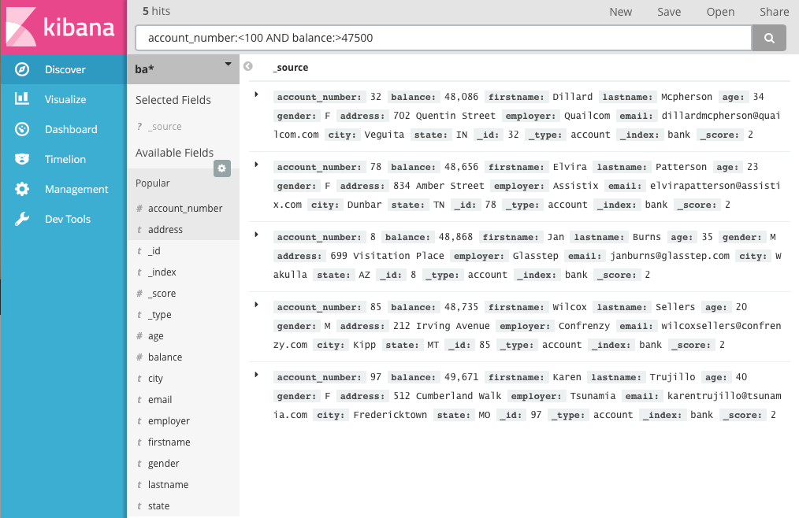
2-3. Discover data:
The current index pattern is displayed beneath the query bar. The index pattern determines which indices are searched when you submit a query.
To try it out, select the ba* index pattern and enter the following query string in the query bar:
account_number:<100 AND balance:>47500

Slide 17
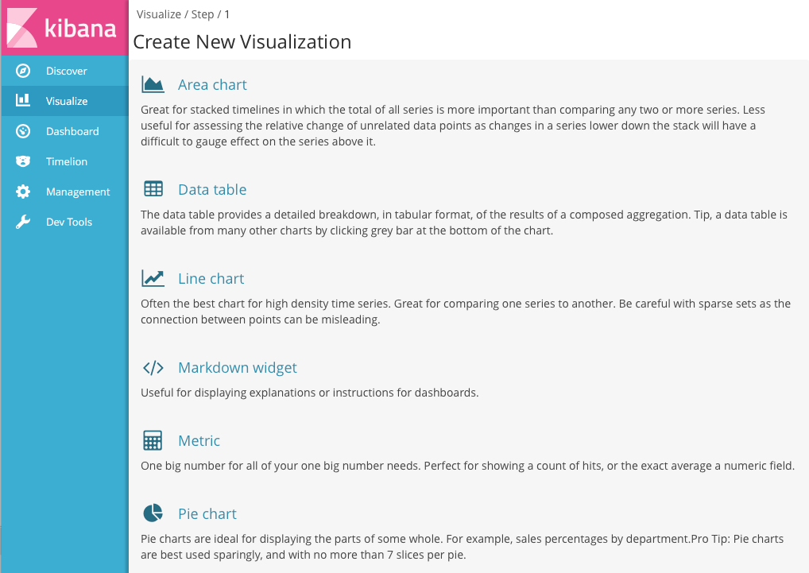
2-4. Set up visualizations of the sample data:
To start visualizing your data, click Visualize in the side navigation:

Slide 18
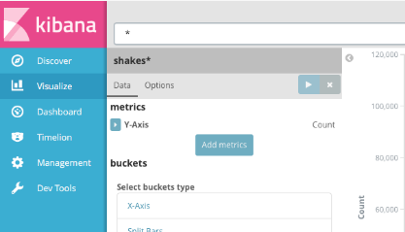
2-4. Set up visualizations of the sample data:
Let’s find out how the plays compare when it comes to the number of speaking parts and display the information in a bar chart:
Click New and select Vertical bar chart
Select the shakes* index pattern. Since you haven’t defined any buckets yet, you’ll see a single big bar that shows the total count of documents that match the default wildcard query.

Slide 19
2-4. Set up visualizations of the sample data:
To show the number of speaking parts per play along the y-axis, you need to configure the Y-axis metric aggregation. A metric aggregation computes metrics based on values extracted from the search results. To get the number of speaking parts per play, select the Unique Count aggregation and choose speaker from the field list. You can also give the axis a custom label, Speaking Parts.
To show the different plays long the x-axis, select the X-Axis buckets type, select Terms from the aggregation list, and choose play_name from the field list. To list them alphabetically, select Ascending order. You can also give the axis a custom label, Play Name.
Click Apply changes to view the results.

Slide 20
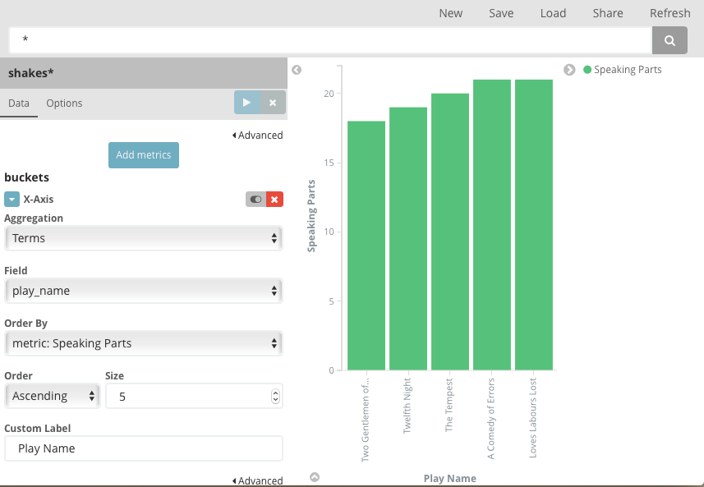
2-4. Set up visualizations of the sample data:

Slide 21
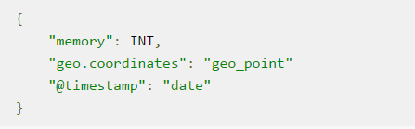
Addition : Geo-location data visulization
Here we use the data from log files that record the IP address's use in U.S.A, the website is:
https://download.elastic.co/demos/kibana/gettingstarted/logs.jsonl.gz
The schema for the logs data set has dozens of different fields, but the notable ones used in this tutorial are:

Slide 22
Addition : Geo-location data visulization
Like the previous Shakespeare dataset, we load the sample data into Elasticsearch:
curl -XPUT http://localhost:9200/logstash-2015.05.18 -d '
{
"mappings": {
"log": {
"properties": {
"geo": {
"properties": {
"coordinates": {
"type": "geo_point"
}
}
}
}
}
}
}
';

Slide 23
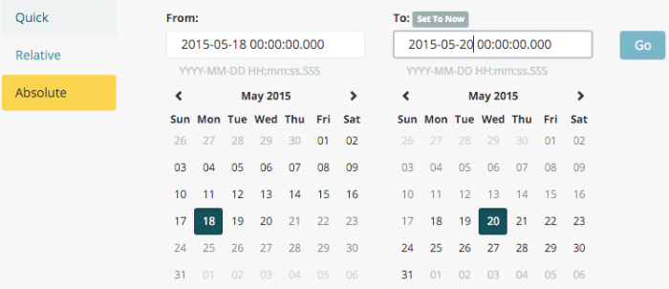
Addition : Geo-location data visulization
At last, we could set up map visulization in the dashboard :
Select Tile map and select the logstash-* index pattern (which we previous defined).
Set the time window for the events we’re exploring:through Absolute , Set the start time to May 18, 2015 and the end time to May 20, 2015:

Slide 24
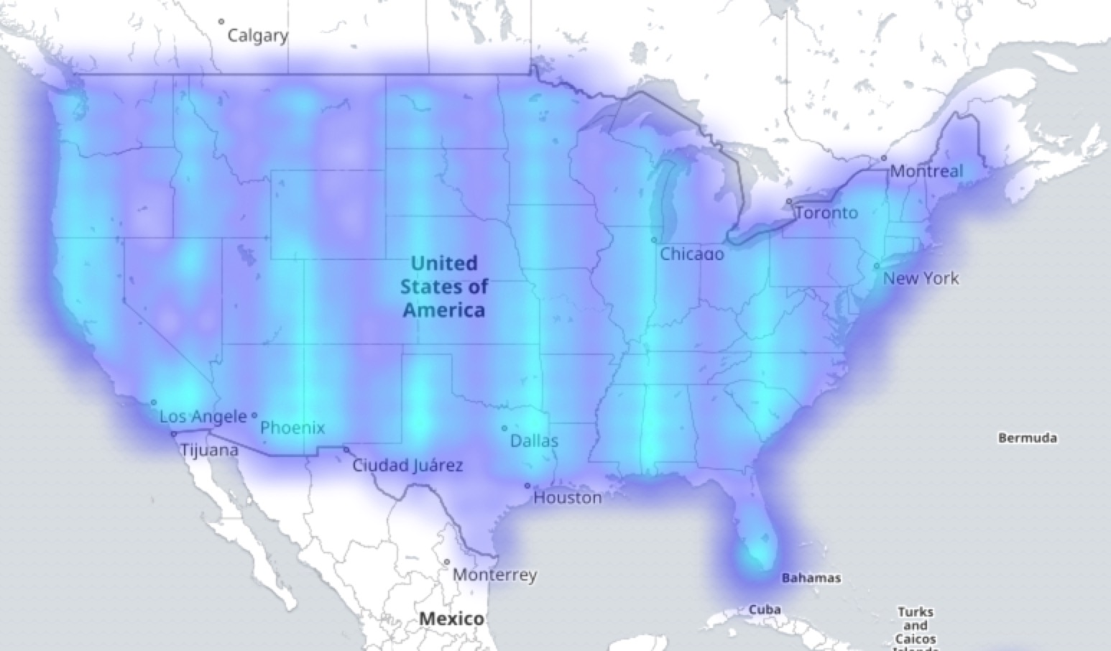
Addition : Geo-location data visulization
To map the geo coordinates from the log files select Geo Coordinates as the bucket and click Apply changes:

